Slide 1
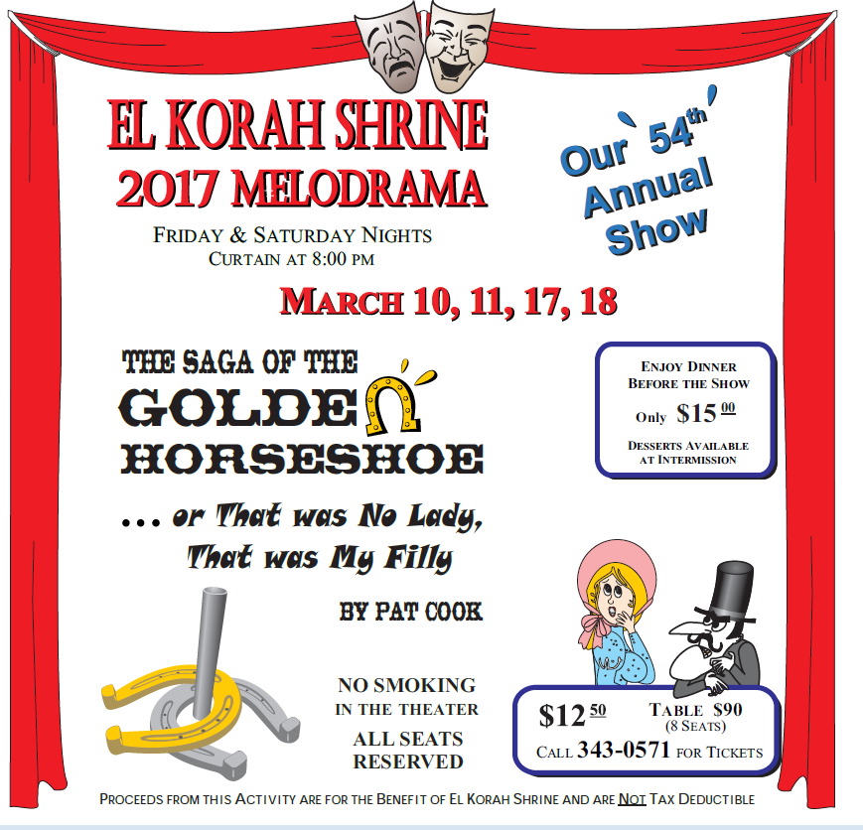
Volume XVII Issue 2 February 2017 El Korah shriners Desert Dust
Official Publication of El Korah Shriners 1118 W. Idaho Street Boise, ID 83702

Slide 2
Page DESERT DUST FEBRUARY 2017
OFFICERS
Elected Officers
Potentate………………….……...Mike Yavno
Chief Rabban…………………Dave Thomas
Assistant Rabban………...Garland Risner
High Priest and Prophet..Rick Holloway
Oriental Guide……………………….…Vacant
Treasurer……………………………Gary Betts
Recorder………………….……Max Bearden
Appointed Divan
Director……………………...……..Will Votaw
Assistant Director…….…….Jesse Laduke
Chaplain……………………….….Stan Barker
1st Ceremonial Master..Ken Beaudreau
2nd Ceremonial Master….…Dale Rutter
Marshal……….….Seth Van Wassenhove
Captain of the Guard……...Justin Boyer
Outer Guards…………..Santa Bob Albert
Bob Cannon, Jim Hansen, Bob Nelson
Aides
Chief Aide…………………………..Dick Swift
Chris Burgess, Bob Carleton, Bill Curtis
Bruce Drewes, Jack Gardner, Rod Horn
Gene Strate
Desert Dust
Editors………….Mike Keas, Rick Holloway
elkorahdesertdust@gmail.com
Assistant Editor………...……..Justin Boyer
Phone Numbers
Recorder……………………..208-343-0571
Oasis…………………………..208-343-1341
Office fax………………….…208-336-1527
Events: Circus, Football.208-333-8350
To that Undiscovered Country
Harold Masters
Lyle Keith, PP
Have you paid
Your 2017 Dues?
Please check your wallet! If you haven’t paid your 2017 Dues yet, please do so today. You can call the Recorder’s office at 208-343-0571 for assistance. It is important to you, your community, and your hospital program!
Editor Notice
The Desert Dust is published monthly except July and August by El Korah Shriners at 118 West Idaho Street, Boise, Idaho 83702
All articles, events, unit activities, announcements, and pictures must be in the hands of the Editor by the 20th of the month preceding the publication month in order to get them in the Dust.
Please submit all articles, pictures, and announcements for publication to elkorahdesertdust@gmail.com or drop them in the Desert Dust mailbox at El Korah.
February Stated Meeting
The next Stated Meeting of El Korah Shriners will be on Wednesday, February 8, 2017 at El Korah Shrine. Dinner will be at 6:30 pm with the meeting beginning at 7:30 pm.

Slide 3
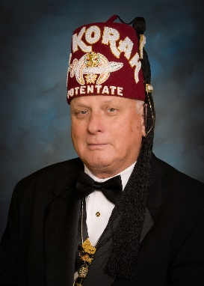
Page DESERT DUST FEBRUARY 2017
Potentate’s Message
By Mike Yavno
Chaplain’s Corner
By Stan Barker, Chaplain
First off, I want to say thank you for allowing me to be your Potentate for 2017. I most respectfully and humbly accept the honor that you have bestowed on me. I am your humble servant.
The weather and calendar tells us that winter is really here. In fact, weather personnel inform us that we have had more snow here than we have experienced since the winter of 1984-85. This weather is causing water problems in the basements for some people.
Lady Carol and I are dedicated to making 2017 a great year. To that end, we and the Divan have a mutual goal to work together, grow the organization, have fun, and take care of our “Shriner Kids.”
My goal is to foster an organization where your elected and appointed Divan work in harmony, in a combined effort to make El Korah better, while we enjoy real camaraderie. In addition, we want to leave the organization financially sound and ready for the Potentate of 2018. I also have a personal goal, and that is to see one young man about 7 or 8 years old raise his hand and say, “I want to be a Shriner!”
You will see numerous communications in the coming months. We want everyone to know what is going on and be a part of the many events that will be taking place during the year.
We are currently working on the 2017 Directory, with a goal to have it available by the second week of February.
My office door will always be open when I am at the temple. It will be closed only in the event of a meeting or private phone call. Please drop in for a minute if you have occasion to be at the temple when I am there.
Fraternally,
Michael G. Yavno (& Lady Carol)
Potentate 2017
El Korah Shriners
February 14 is of course a special day in which we should recognize our loved ones. This is St. Valentine’s Day.
Two days in the history of our country which should be noted are February 12, the birth date of Abraham Lincoln, and February 22, the birthday of the Father of our Country, George Washington. We hope appropriate steps will be taken so that the history of our country will be preserved as our founding fathers wanted.
Sunday, January 8 marked a special day for El Korah Shrine. The Officers and Divan Members for 2017 were installed. The weather was not favorable, but the Installation was held. Mike Yavno was installed as Potentate for El Korah Shrine for the year 2017, and the rest of the Divan members were installed as well. A reception was held for all present.
If anyone knows persons who need the attention of the Chaplain, please notify Noble Stan Barker, Chaplain for 2017.
As we are beginning a new year, let us remember Genesis, Chapter 1, Verse 1,
‘In the beginning God created the Heaven and the Earth.” Let us all share in being less critical and more forgiving and understanding throughout the new year of 2017.
SHALOM

Slide 4
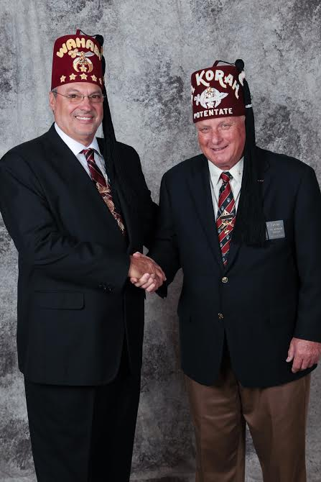
Page DESERT DUST FEBRUARY 2017
Portland Shrine Hospital Report
The Portland Shrine Hospital had a very successful 2016. Total surgeries, inpatient days, and outpatient visits increased over last year. Dr. Krister Freese, MD, joined the hospital late this year and is already making a significant impact with his focus on hand and upper extremity surgeries. The Providence agreement is fully implemented and allows us to be partners with the largest hospital system in Oregon.
Noble Len Wyllie from Penticton, BC returned as Chair of the Portland Board of Governors this year. Dave Worel from Al Aska Shrine in Anchorage is the Vice Chair, and Ron Eggers is Treasurer. From El Korah Shrine, Dave Triplett will be serving as Vice Chair of the Credentials Committee for 2017 and Rick Holloway will chair the New Services Development Committee and serve on the Nominating Committee.
There will be additional vacancies on the Board of Governors later this year, and we will be seeking Nobles in good standing who are able to contribute to the success of the Portland Hospital. Please contact Dave Triplett or Rick Holloway for more information on the Portland Hospital and what it means to be a member of the Board of Governors.
Notice of Stated Meeting
And
Election of Oriental Guide
Wednesday, March 8, 2017
El Korah Shrine
1118 W. Idaho, Boise, ID
Social Hour 6:00 pm
Dinner 6:30 pm
Meeting 7:30 pm
Your dues card will be required at the door. Should you have any questions, please contact the Recorders office at 208-343-0571
Your attendance is encouraged!
Imperial Potentate Chris Smith and your 2017 El Korah Potentate
Mike Yavno

Slide 5
Page DESERT DUST FEBRUARY 2017
Date: February 10, 2017
Where: El Korah Shrine
Time: 6 PM Dinner, Bunco to follow
Price: $20 per person
Dinner will be Sloppy Joe's and Salad
There will be prizes, a Dessert Auction and of course, BUNCO!
Tickets are available from Iras Temple No. 40 Guard Members, the office at El Korah Shrine or at the door

Slide 6
Page DESERT DUST FEBRUARY 2017
Did You Know?
EL KORAH SHRINERS COMING EVENT
FEBRUARY 2017
2/6 – Director/Divan meeting at El Korah (Divan Ladies invited)
2/8 – Stated meeting at El Korah
2/11 Sand Duner Sweetheart Auction and Dance
2/12 Greeters Valentine Brunch-Riverside Hotel
2/16 – 2/18 Winter PNSA-Wilsonville, OR Divan and Nobles only
3/4 Melodrama-Senior Performance
This notice will be will be sent out regularly so our Nobles may know of events and activities going on at El Korah.
The 2017 Directory should be available to all Nobles within the next two weeks. Please refer to your Directory for information on Units, Clubs, Officers, and events.
If in doubt about an event, please call the Recorder’s office at 208-343-0571. Remember to book events with the Recorder at least 60 days in advance of the event date.
Greeters Greetings
The Greeters Unit is starting off 2017 with new vigor as Noble Art Kilton assumes the office of President. You will see Art and the other Greeters at every Stated meeting, and the February 8 Stated meeting will be no different. The annual Greeters Valentine’s Day brunch is always well attended, and will be held at the Riverside Hotel on February 12 this year.
There is a full schedule of meetings and exciting programs at the monthly Greeters meetings, held on the first Friday of each month. For more information on the Greeters, please contact Noble Art at arthurkilton1@msn.com.
Players Playbill
It is the beginning of February, and everyone knows what that means….The Melodrama is almost here!! This year’s performance is “The Saga of the Golden Horseshoe” or “That was no Lady, That was My Filly!” Rehearsals have been going on for a month now with the exception of the week when old man winter threw us a curveball and closed down the city.
Expect to find many of the returning stars of the Melodrama as they take to the stage once again for this memorable performance. Tickets are on sale now at the Recorder’s office. Performances will be held on March 10-11 and 17-18. Dinner is available each night, with the Players putting on a corned beef and cabbage dinner on Friday, March 17. Don’t miss this!
Commercial and Residential Cleaning Services
Commercial and Residential Carpet Cleaning
Owner: Glen and Darla Butz
208-724-7619
In the Oasis
Gayle Chapman on the piano
Every Tuesday night 6-8 pm
Oasis is open M-F 4 pm to 8 pm

Slide 7
Page DESERT DUST FEBRUARY 2017

Slide 8
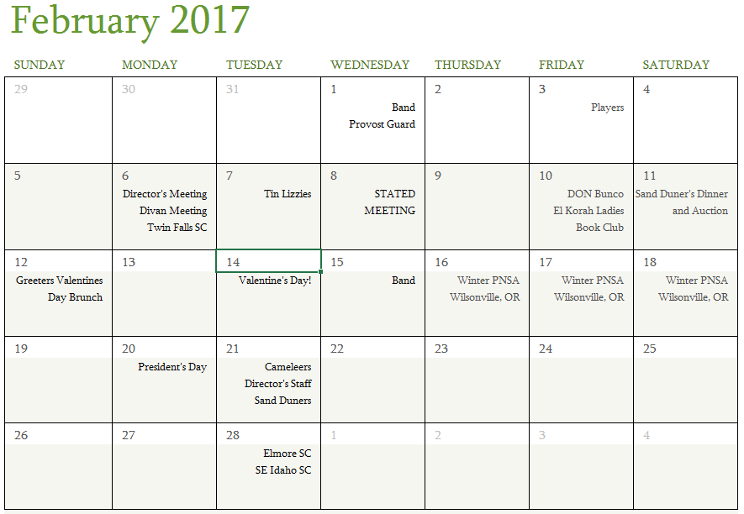
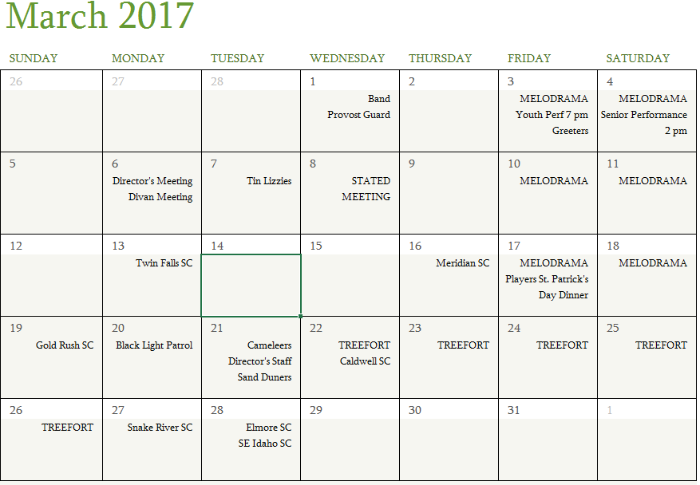
Page DESERT DUST FEBRUARY 2017

Slide 9
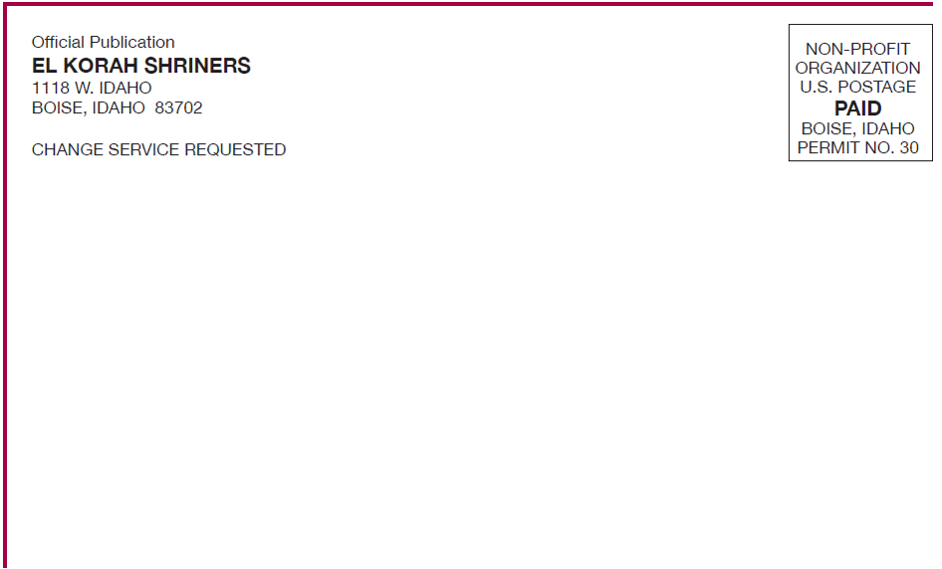
Page DESERT DUST FEBRUARY 2017
Join your fellow Nobles and friends in a Super Bowl party at El Korah! Sunday, February 5, 2017 starting at 3:30 pm

